Slide 2
Organizational theory: The study of how organizations function and how they affect and are affected by the environment in which they operate

Slide 3
Organization: A tool people use to coordinate their actions to obtain something they desire or value

Slide 4
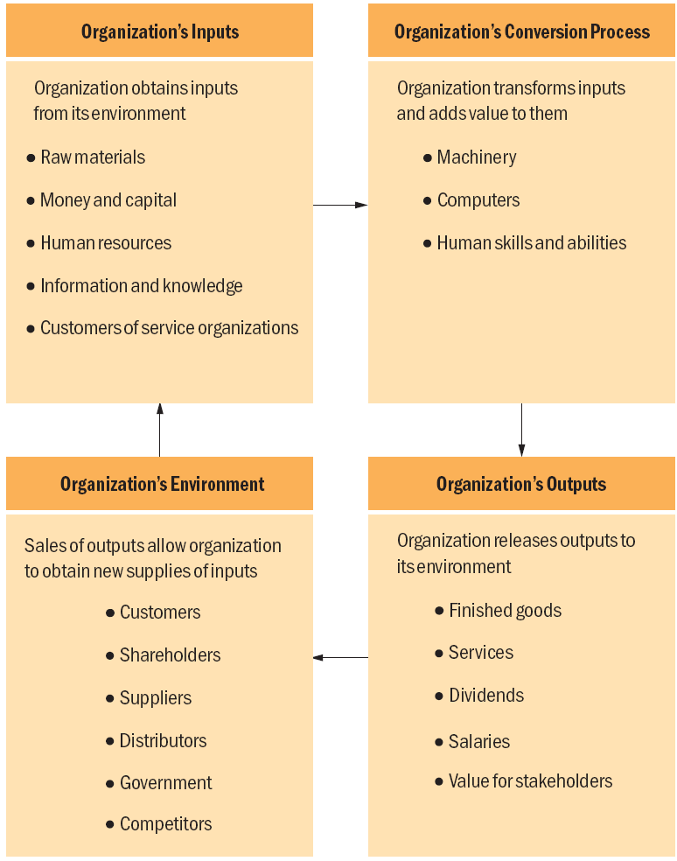

Slide 5
Organizations increase specialization and the division of labor
Division of labor allows specialization
Specialization allows individuals to become experts at their job
It may also lead to their getting bored with repetitive tasks
Organizations can also use large-scale technology that brings them
Economies of scale: Cost savings that result when goods and services are produced in large volume on automated production lines
Economies of scope: Cost savings that result when an organization is able to use underutilized resources more effectively because they can be shared across different products or tasks

Slide 6
Organizational environment: The set of forces and conditions that operate beyond an organization’s boundaries but affect its ability to acquire and use resources to create value
Organizations need to manage their environment
An organization’s environment is the source of valuable input resources and is the marketplace into which it releases outputs
It is the source of economic, social, and political pressures that affect an organization’s ability to obtain these resources

Slide 7
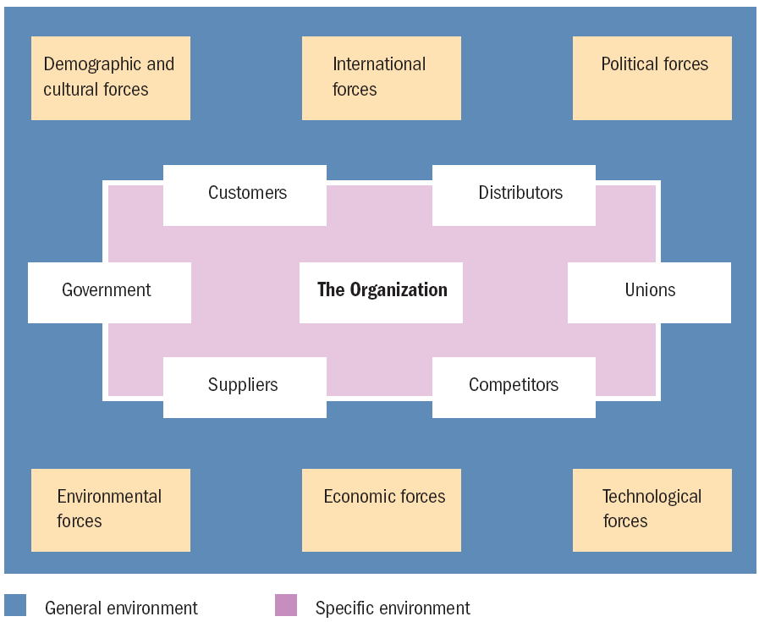
Organization’s Environment

Slide 8
Organizational structure: The formal system of task and authority relationships that control how people coordinate their actions and use resources to achieve organizational goals
Organization Effectiveness: The degree to which an organization is able to fulfil its objevtives
Ways of measuring effectiveness:
Control approach
Control - Having control over the external environment and having the ability to attract resources and customers
Innovation - Developing an organization’s skills and capabilities so the organization can discover new products and processes

Slide 9
Ways of measuring effectiveness:
Control approach
Having control over the external environment and having the ability to attract resources and customers
Innovation approach
Developing an organization’s skills and capabilities so the organization can discover new products and processes
Efficiency approach
Developing modern production facilities using new information technologies that can produce and distribute a company’s products in a timely and cost-effective manner

Slide 10
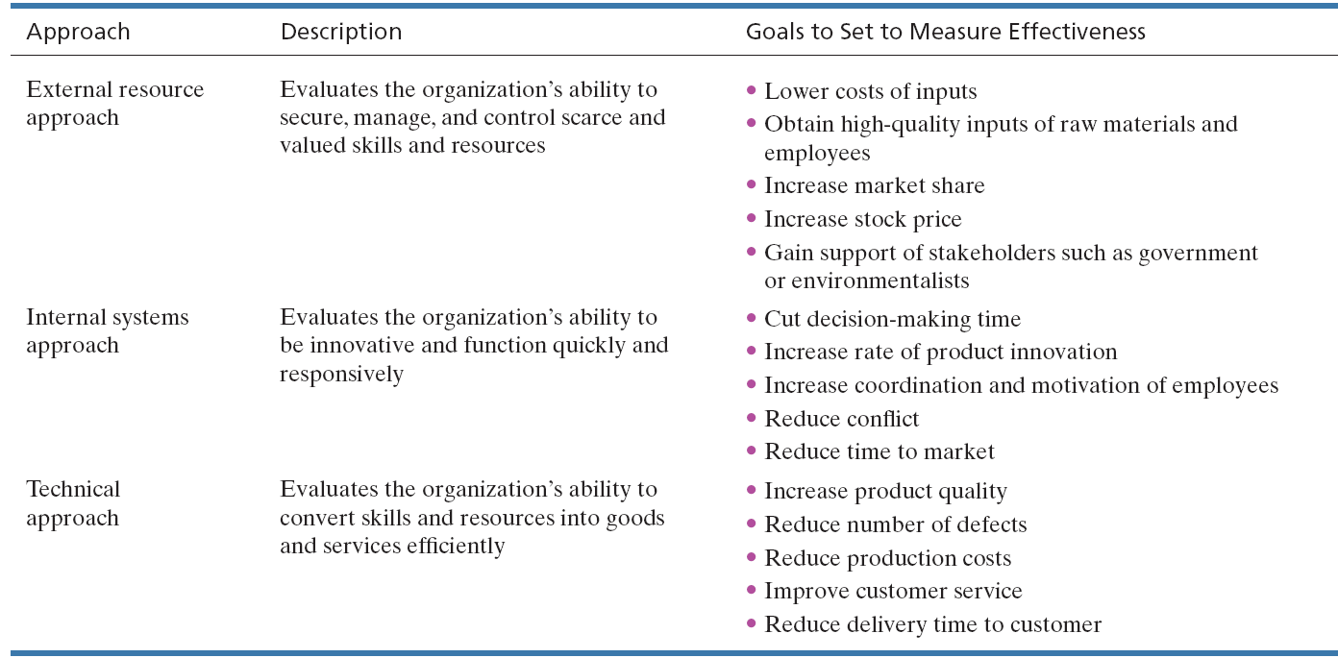

Slide 11
Organization’s Stakeholders
Stakeholders: People who have an interest, claim, or stake in an organization, in what it does, and in how well it performs
Inducements: Rewards such as money, power, and organizational status
Contributions: The skills, knowledge, and expertise that organizations require of their members during task performance

Slide 12
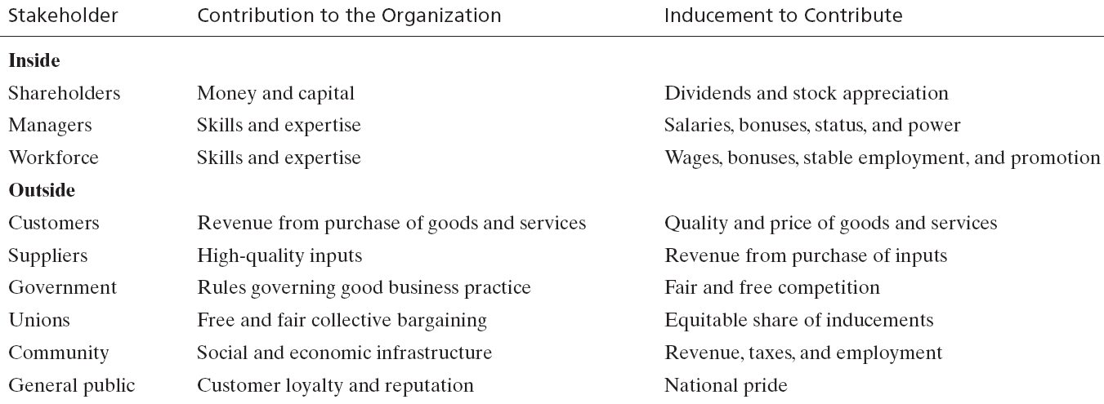

Slide 13
An organization is used simultaneously by various stakeholders to achieve their goals
Each stakeholder group is motivated to contribute to the organization
Each group evaluates the effectiveness of the organization by judging how well it meets the group’s specific goals
Evaluation of the organization
Shareholders - Return on their investment
Customers - Product reliability and product value relative to their price
Managers/Employees - Compensation, working conditions, career prospects

Slide 14
To be effective an organization must at least minimally satisfy the interest of all stakeholders
It faces problems in
Which stakeholder group to satisfy
How to allocate resources among various stakeholders with competing claims
Balancing short term and long term goals
One way to figure out which stakeholder is most dominant is to look at as to who heads the organization. Person heading the organization has expertise that can handle the most important stakeholder.

Slide 15
Elements of structure
Horizontal Differentiation
People organized according to the differences in tasks and expertise
Vertical Differentitaion
People organized according to the differences in level of authority
Geographical Differentitaion
People organized according to differences in geography

Slide 16
Chain of command: The system of hierarchical reporting relationships in an organization
Hierarchy: A classification of people according to authority and rank
Span of control: How many people can be effectively supervised by a manager
Depends on complexity and interrelatedness of the subordinates’ task

Slide 17
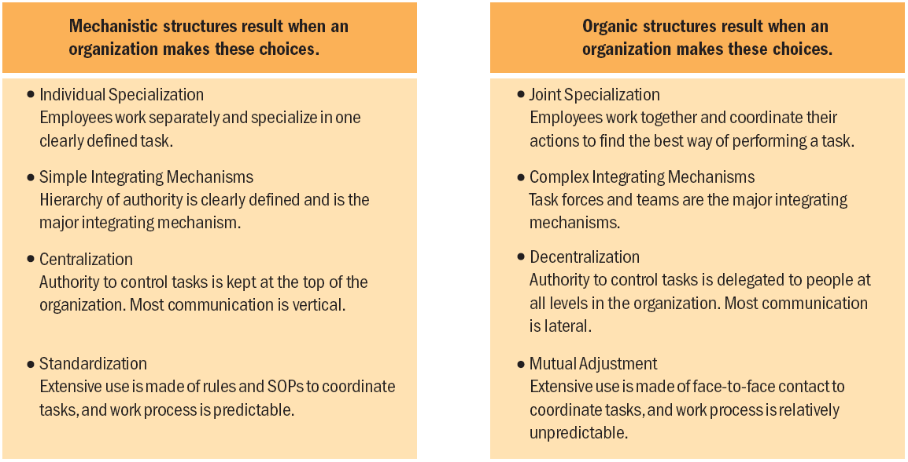

Slide 18
Organizations need different kinds of structure to control their activities based on the environment
Organic structures are more effective when the environment is unstable and changing
Mechanistic structures are more effective in stable environments

